Slide 1
Building a Scalable Recommendation System Using Amazon Reviews Data
Pangkaew Chansri
Lancaster University, p.chansri@lancaster.ac.uk
Emily Gomer
Lancaster University, e.gomer@lancaster.ac.uk
Torin Lindsay
Lancaster University, t.lindsay@lancaster.ac.uk

Slide 2
Project Overview
Pipeline:
Amazon Review Dataset ↓ Data Cleaning ↓ Task 1: Database Systems ↓ Task 2: Vector Similarity ↓ Task 3: Clustering ↓ Task 4: Recommendation System

Slide 3
Amazon Review Data Set 2023
Product Feature | Datatype
Column_Name | Data_Type
main_category | str
title | str
average_rating | float64
rating_number | int64
features | object
description | object
price | float64
images | object
videos | object
store | str
categories | object
details | object
parent_asin | str
bought_together | float64
User Feature | Datatype
Column_Name | Data_Type
rating | int64
title | str
text | str
images | object
asin | str
parent_asin | str
user_id | str
timestamp | datetime64[ms]
helpful_vote | int64
verified_purchase | bool
571 million reviews
33 product categories
All_Beauty subset
Reviews + Product metadata

Slide 4
DATA PRE-PROCESSING
Pipeline:
Convert text to string and remove html and links ↓ Convert Emoji to their meaning ↓ Normalise to lower case ↓ Tokenisation and remove stop words ↓ Lemmatisation and fix elongated words ↓ Join tokens back to single string

Slide 5
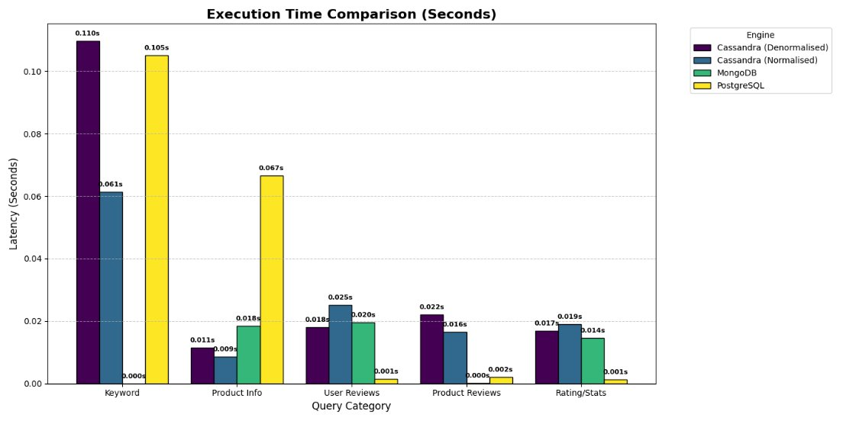
Task 1: Database System Comparison
Query | Cassandra (Denormalised) | Cassandra (Normalised) | MongoDB | PostgreSQL
Keyword | 0.109723568 | 0.061454058 | 3.05E-05 | 0.105151176
Product Info | 0.011496067 | 0.008658409 | 0.0183589 | 0.066627979
User Reviews | 0.018063784 | 0.025197744 | 0.0196331 | 0.00144887
Product Reviews | 0.022074699 | 0.0164783 | 7.37E-05 | 0.001986027
Rating/Stats | 0.016877413 | 0.01901269 | 0.0144997 | 0.001348257
Totals | 0.178235531 | 0.130801201 | 0.0525959 | 0.176562309

Slide 6
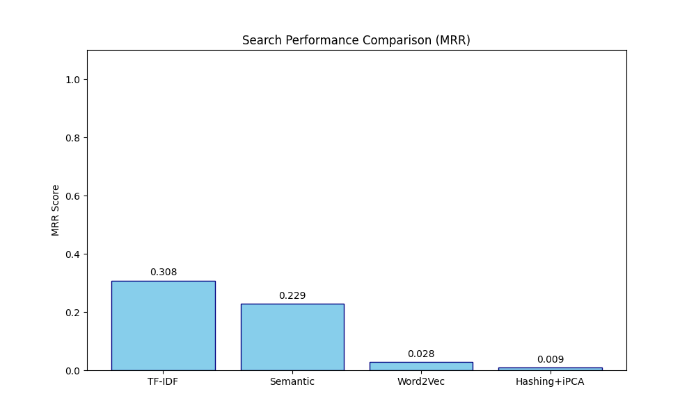
Vectorisation
Method | MRR
TF-IDF | 0.308333
Semantic | 0.229167
Word2Vec | 0.027778
Hashing+iPCA | 0.009259

Slide 7
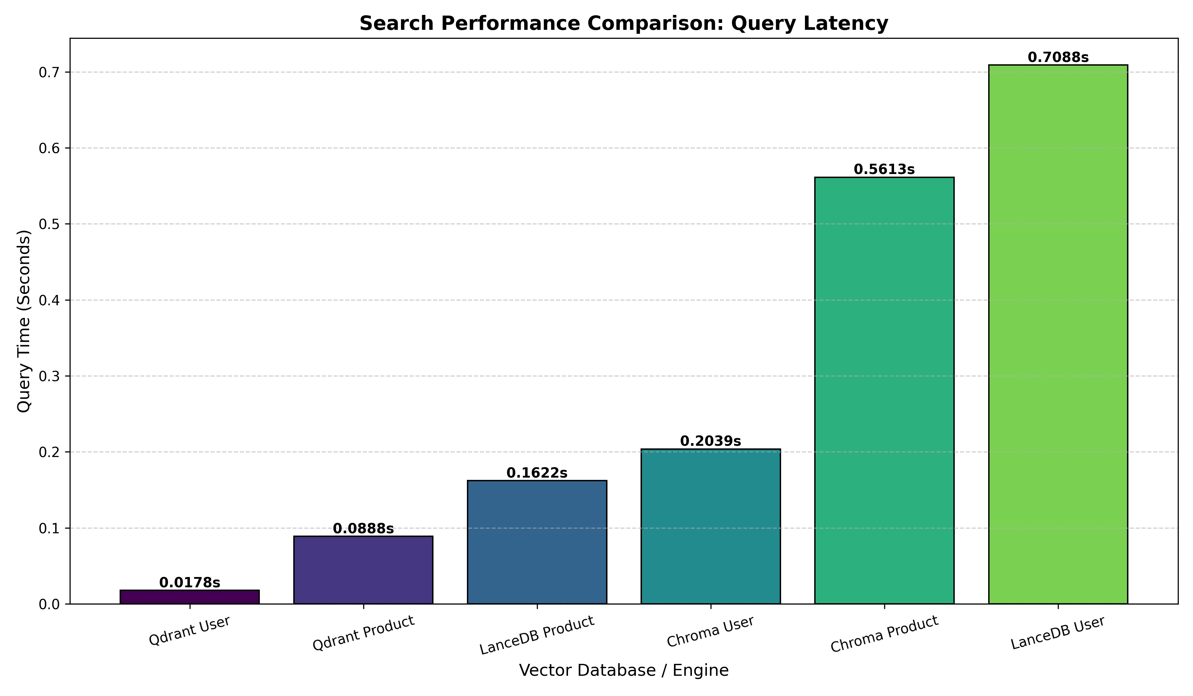
Task 2: Vector Database Comparison
Engine | Time (Seconds)
Qdrant User | 0.01781559
Qdrant Product | 0.08884263
LanceDB Product | 0.162170887
Chroma User | 0.20390892
Chroma Product | 0.561287403
LanceDB User | 0.708806276

Slide 8
Task 2: Vector Similarity Search
Rank - Product | ASIN | Product Title | Similarity
1 | B07QWBWKVW | wide tooth comb curly hair nat.. | 0.927
2 | B07BJ492JM | wood comb wooden hair comb 100.. | 0.921
3 | B07BF4T557 | wood comb wooden hair comb 100.. | 0.921
4 | B07WPL2LZJ | wood comb anti static natural .. | 0.908
5 | B07S7P8NJ5 | xuanli hair comb detangling wi.. | 0.901
6 | B07PPBJFWC | xuanli hair comb detangling wi.. | 0.901
7 | B079VHXTXP | wood comb wooden hair comb 100.. | 0.9
8 | B07QX9XTKR | natural buffalo horn comb ruby.. | 0.899
9 | B0778RTNWT | thee natural horn comb anti st.. | 0.892
10 | B0778HW8QF | thee natural horn comb anti st.. | 0.892
Rank - User | User ID | Similarity
1 | AHV6QCNBJNSGLATP56JAWJ3C4G2A | 0.706
2 | AGPVUWYFDS4WHWJJC4336KQUTAPQ | 0.678
3 | AFS5MAXWHQNKTORY7CNERRHNV7DA | 0.671
4 | AEDRFBA64VH2SHGAB5W27J4ZTKHA | 0.667
5 | AFKSNZYMIZ6WAU3A7RREIJ3RIABA | 0.665
6 | AHY6N2ZTVLFE7N5OWEPCG2C3ODTQ | 0.665
7 | AHSMHVELSPKUCSUPDPNRJE2JOIFQ | 0.665
8 | AF7SECCKJFGECV6A7YJEZL2NWFXA | 0.663
9 | AHYCC2Y7SQ6QRFSUKDTAUWWAH2FA | 0.662
10 | AGQVY4TAXPWFHDCKVXJG5KMXBKFA | 0.662

Slide 9
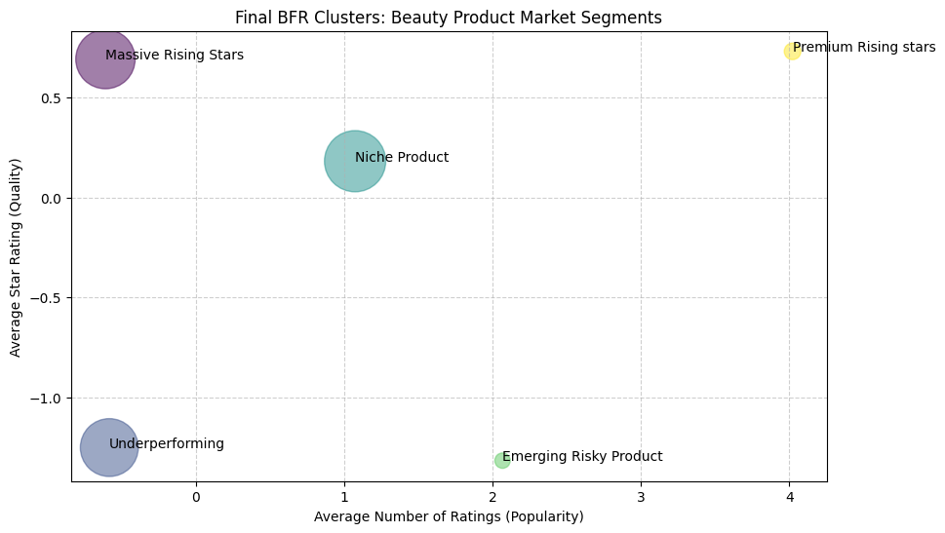
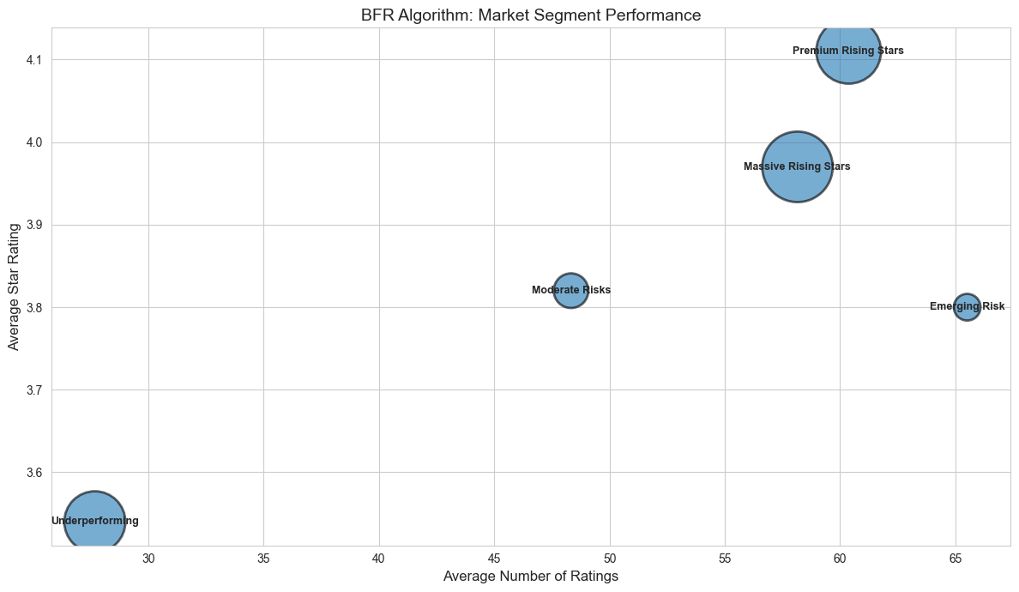
Task 3 :Product Clustering
Business insights
Improve product quality for risky products
Use viral products for marketing

Slide 10
Task 3 : Review clustering
Cluster Name | Sentiment Score | Review Length
Premium Negative Review | -0.59 | 387.92
Premium Positive Review | 0.85 | 453.33
Standard Negative Review | -0.7 | 70.49
Stand Positive Review | 0.78 | 74.48
Business insights
Analyse premium negative reviews for detailed product feedback
Target customer for specific season
Marketing strategies : win-back for Long-Recency Customer
Cluster Name | Cluster Size | Average Recency | Seasonal Profile
Summer customer | 143621 | 1,676 days | 100% Summer
Winter customer | 148763 | 1,708 days | 100% Winter
Spring customer | 153610 | 1,730 days | 100% Spring
Autumn customer | 138525 | 1,729 days | 100% Autumn
Long-Recency Winter customer | 12060 | 2,200 days | 100% Winter
Summer customer | 35407 | 1,673 days | 33% Summer

Slide 11
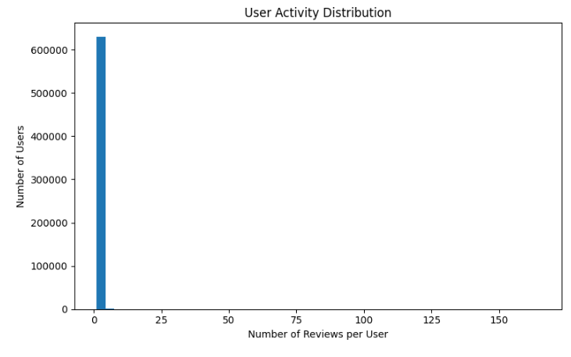
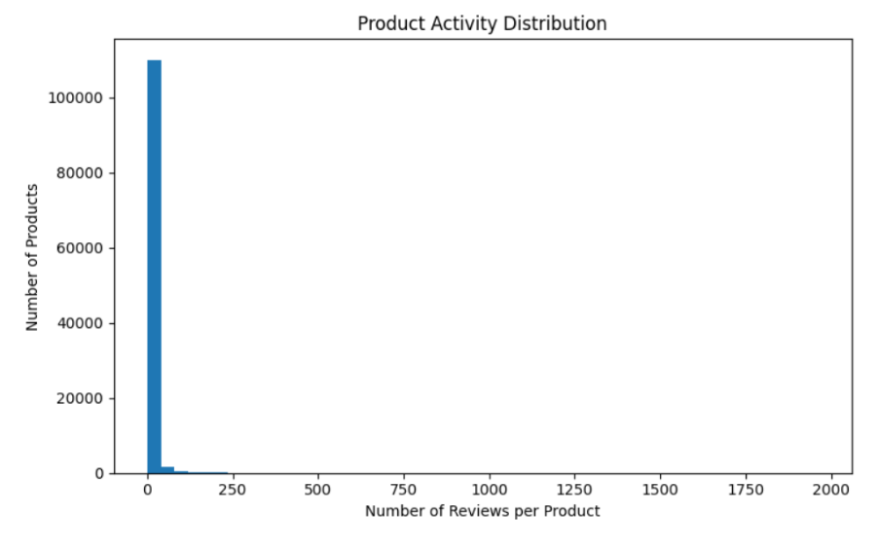
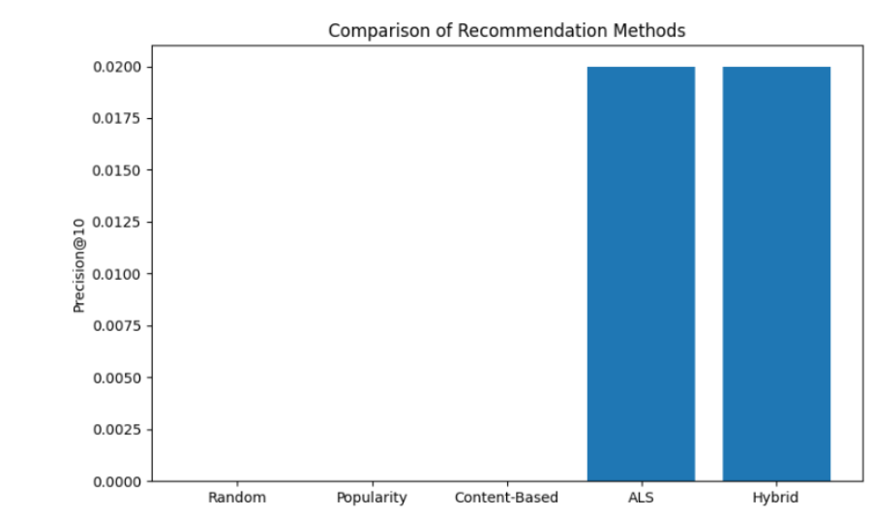
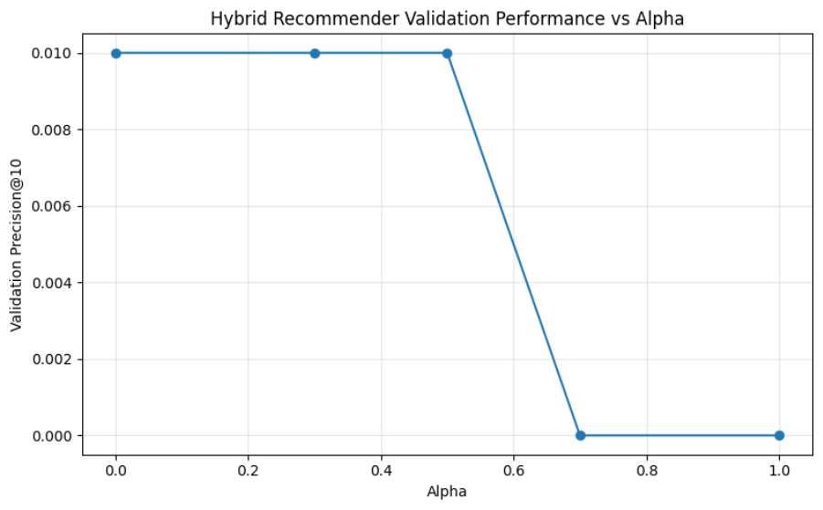
Task 4 Recommendation Systems
Notes:
2 non personalised as baseline in order on screen
Content
Collaborative
Hybrid
Alpha – so pure als cant really count hybrid
But shows better than baseline still
Sparse data – users and product – mean not enough data to train on
Shows importance of using implicit data as explicit is hard to get.

Slide 12
Conclusion & Future Work
Findings:
Mongo – Qdrant – Bi-Secting K-means – Hybrid Recommender
Use more databases
Improve vector embeddings
Experiment with deep learning recommenders
Test on larger datasets

